Slide 1
Aqueous Transmission
Stephanie Cary
Shaun Lally
Jesse Snider
Staci Torrey

Slide 2
Introduction
C++ Library for Audio and Music: a frame work for research and app development in the audio/music domain
Contains conceptual models with visual display
Understand sound's components for further abstraction
Capacity to scale, personalize, integrate

Slide 3
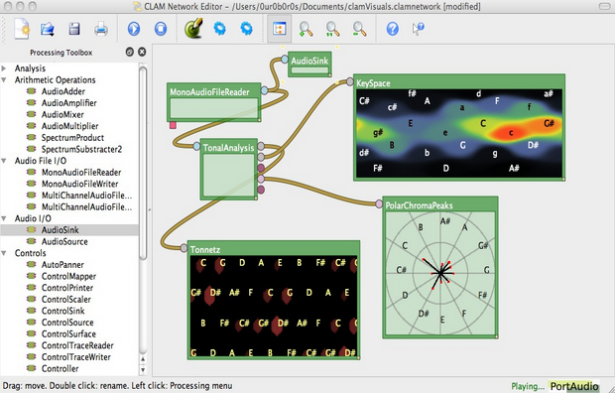
CLAM's visual builder
Network Editor
"It is a patching tool to graphically connect processing units in a network that you can use as the processing core of your application"

Slide 4
Testing
Test Suite
Python Scripts
Tests
Network Editor
Network Components
AudioFileMemoryLoader
AudioSink
MonoAudioFileReader
MonoAudioFileWriter

Slide 5
Testing Contd.
Tests
Audio Files
.ogg
.mp3
.m4a
.aac
.vox
.wma
.wav

Slide 6
Injecting Faults
~clam/CLAM/src/audiofileio/codecs/MpegCodec.cxx
~clam/CLAM/scons/libs/audioio/src/MpegCodec.cxx
OLD:
Bool MpegCodec::IsReadable…if(ext != “mp3” ||ext != “mpg”||ext != “mpeg”)
Return false;
NEW:
Bool MpegCodec::IsReadable…if(ext == “mp3” ||ext == “mpg”||ext == “mpeg”)
Return false;
This will cause MP3 audio files to be rejected when they should be able to play.

Slide 7
Injecting Faults Contd.
~clam/CLAM/src/audiofileio/processings/MonoAudioFileWriter.cxx
~clam/CLAM/scons/libs/audioio/src/MonoAudioFileWriter.cxx
OLD:
if( !mFile.GetHeader().HasChannels())
Return AddConfigErrorMessage("The file is not writeable!");
NEW:
if( mFile.GetHeader().HasChannels())
Return AddConfigErrorMessage("The file is not writeable!");
This will prevent the MonoAudioFileWriter component from writing an audio file.

Slide 8
Injecting Faults Contd.
~clam/CLAM/src/audiofileio/processings/MonoAudioFileReader.cxx
~clam/CLAM/scons/libs/audioio/src/MonoAudioFileReader.cxx
OLD:
const std::string & location = mConfig.GetSourceFile();
if ( location == "") {
AddConfigErrorMessage("No file selected");
return false; }
NEW:
const std::string & location = mConfig.GetSourceFile();
if ( location != "") {
AddConfigErrorMessage("No file selected");
return false; }
This will prevent the MonoAudioFileReader from playing any supported audio files.

Slide 9
Experience
Rough Beginnings
'Mentors' non-existent
Documentation - what is that?
Hope Begins to Glimmer
Building Success
Structure Provided
Challenges in Testing
Massive Project

Slide 10
Lessons Learned
Linux - Learning the Language
XML - Parsing the CLAMNetworks
Documentation - It really IS important!
Testing Strategy - Get to know the code first!
Perseverance & Optimism

